Slide 1
An American Brand

Slide 2
Our vision:
To enhance the lives of the people we touch
Our mission:
We achieve our vision by offering innovative, on trend, high-quality products of exceptional value, supported by unparalleled service.

Slide 3

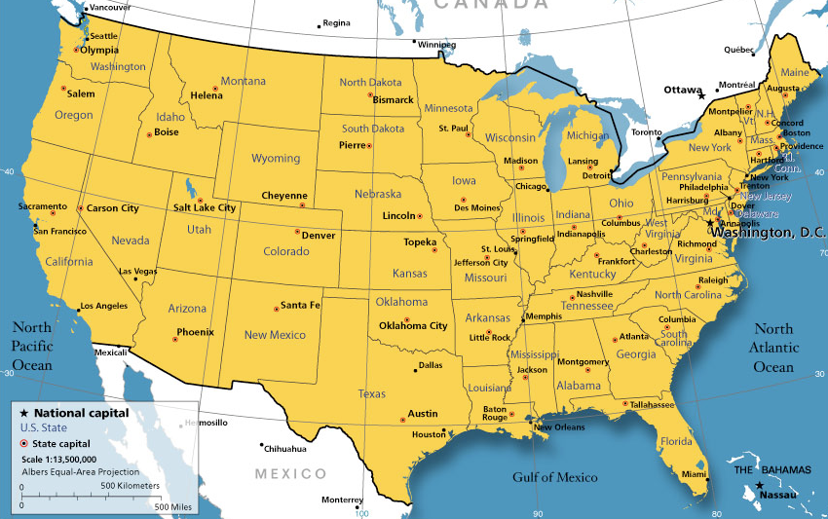

Slide 4


Attributes of VA and NC
Rolling hills
Agriculture
Tobacco
Textiles
Furniture factories
Lumber
Martinsville, VA

Slide 5


Slide 6


Slide 7


Slide 8


Slide 9


Slide 10


Slide 11

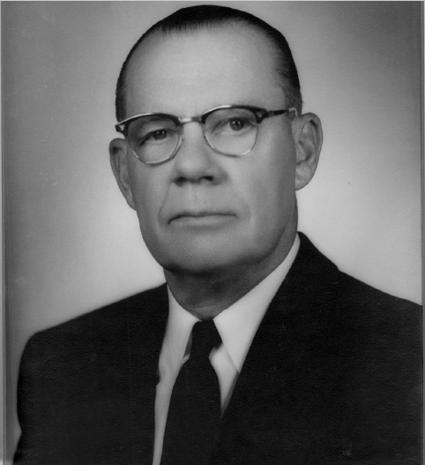
Clyde Hooker Sr. – Founder
Started in 1924 at age 29
Distinction that the family that started the company still runs the company today. Never purchased or sold.

Slide 12

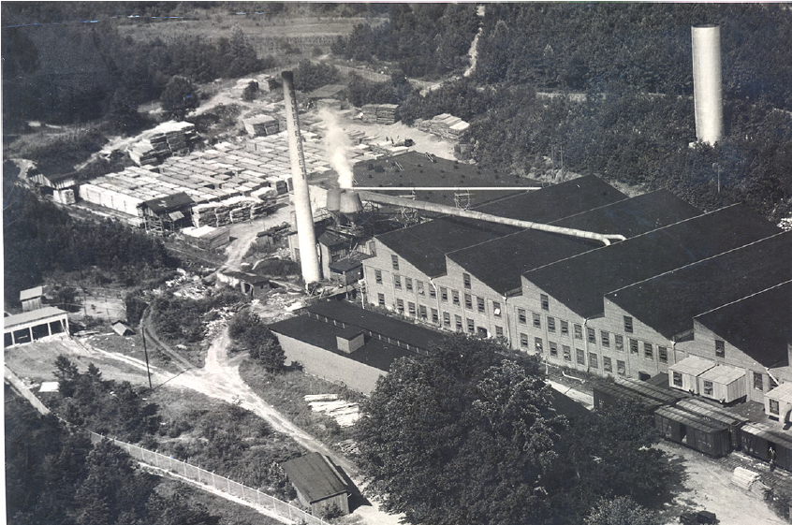

Slide 13

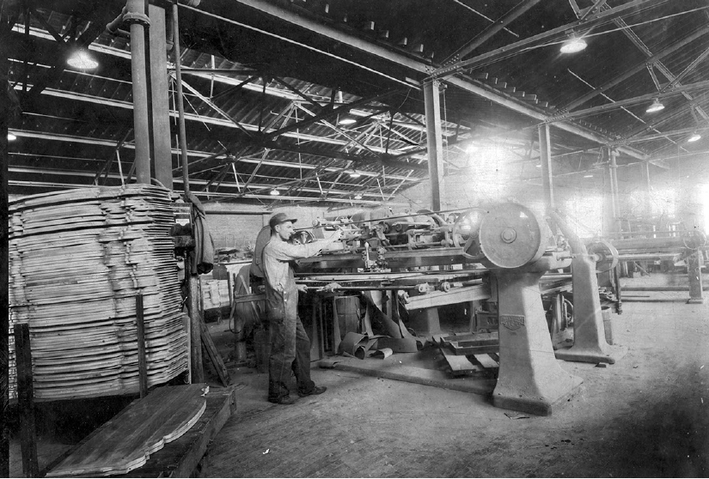

Slide 14

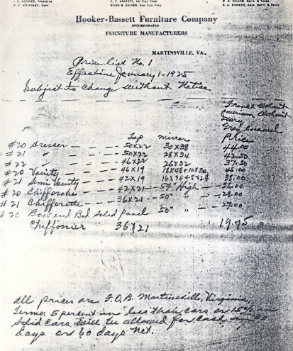

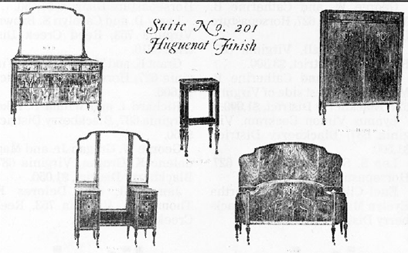

Slide 15

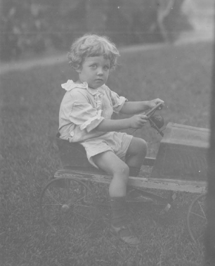

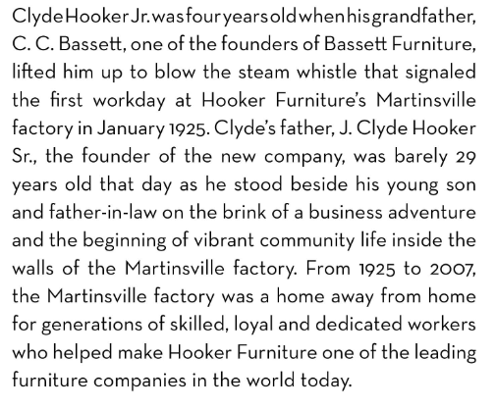

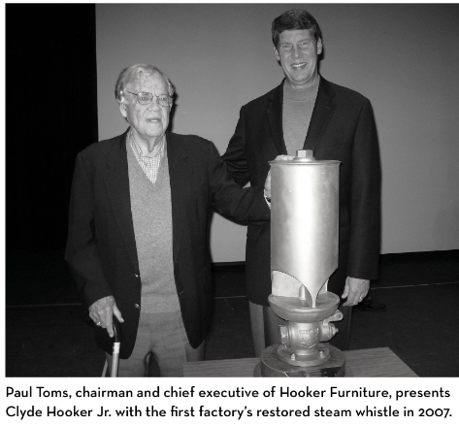
Clyde Hooker Jr.
At age 4, Clyde Jr. pulls the steam whistle to open the factory

Slide 16

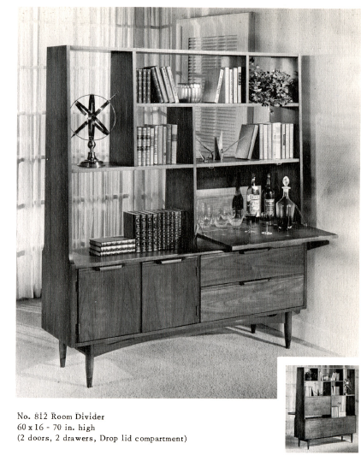

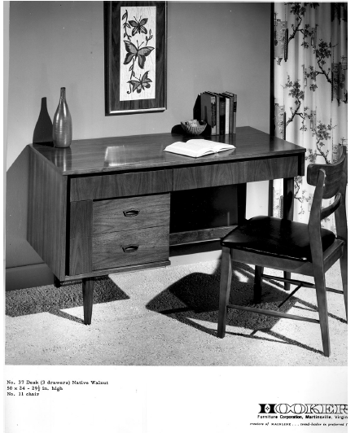

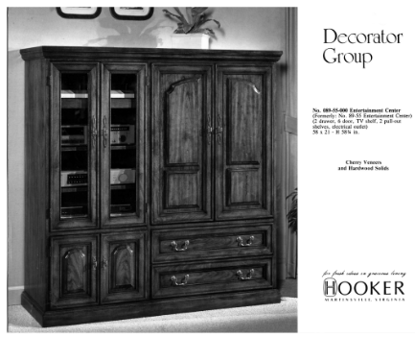

Slide 17

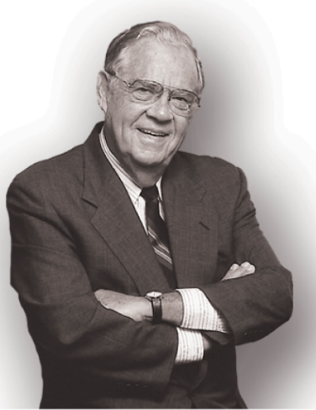

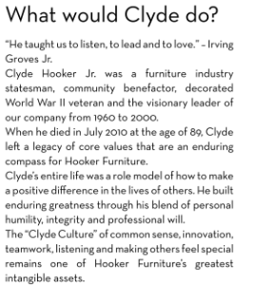
Hooker Core Values
Innovation
Citizenship
Caring
Responsibility
Integrity
Service
Listening
Honesty
Mission Statement: To enhance the lives of the people we touch through innovative home furnishings of exceptional value.

Slide 18

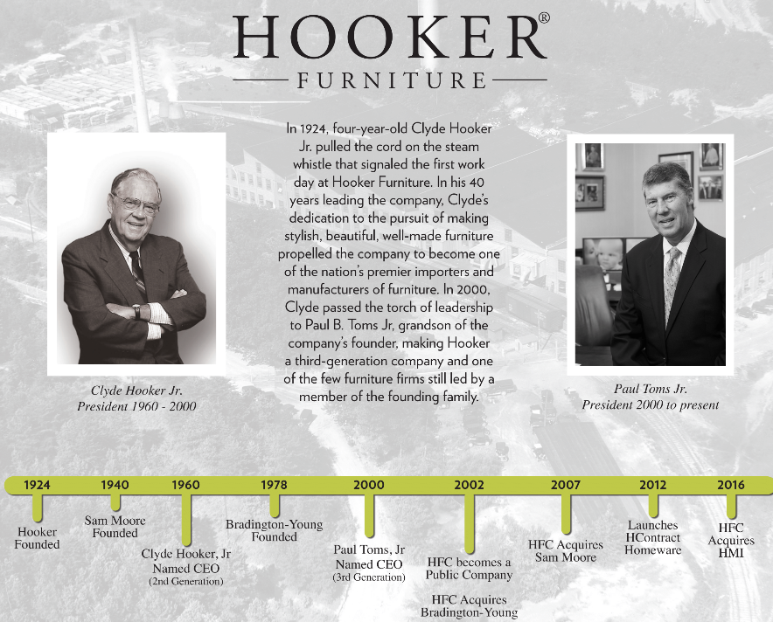

Slide 19
Other noteworthy facts about Hooker
Year 1929
Hooker Today
Benefit to you = Design Leadership and Financial Stability
Industry-leading Inventory Commitment

Slide 20



















Ranked #5 – Publicly traded furniture companies in the USA
Largest importer of casegoods into the USA

Slide 21
An American Brand

